Slide 1


Cinema
WCF Services - Console Application

Slide 2
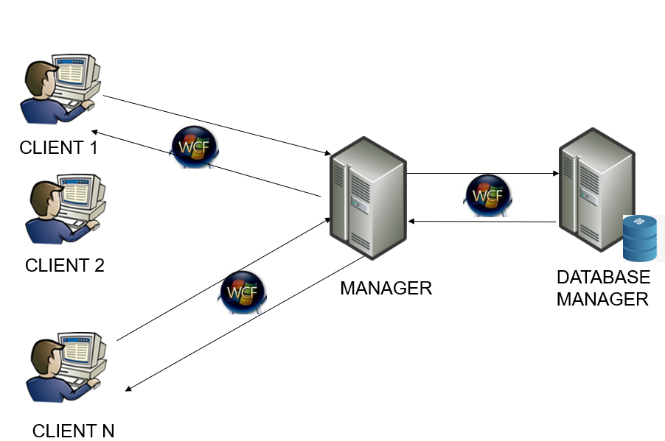
System Architecture

Slide 3
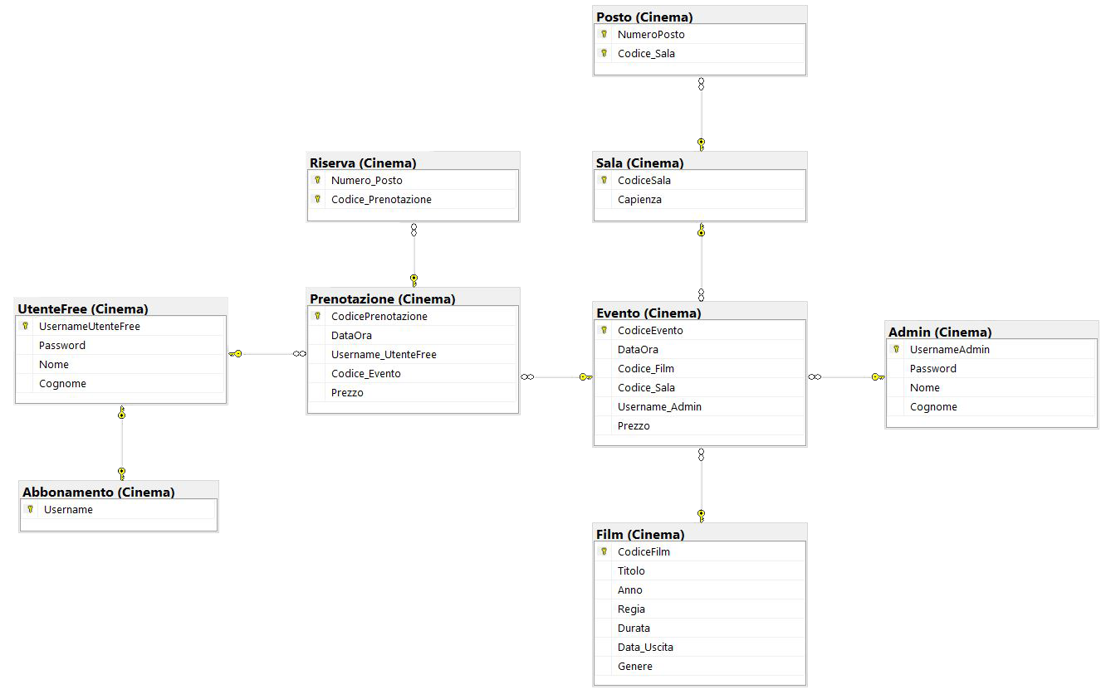

Database Scheme

Slide 4
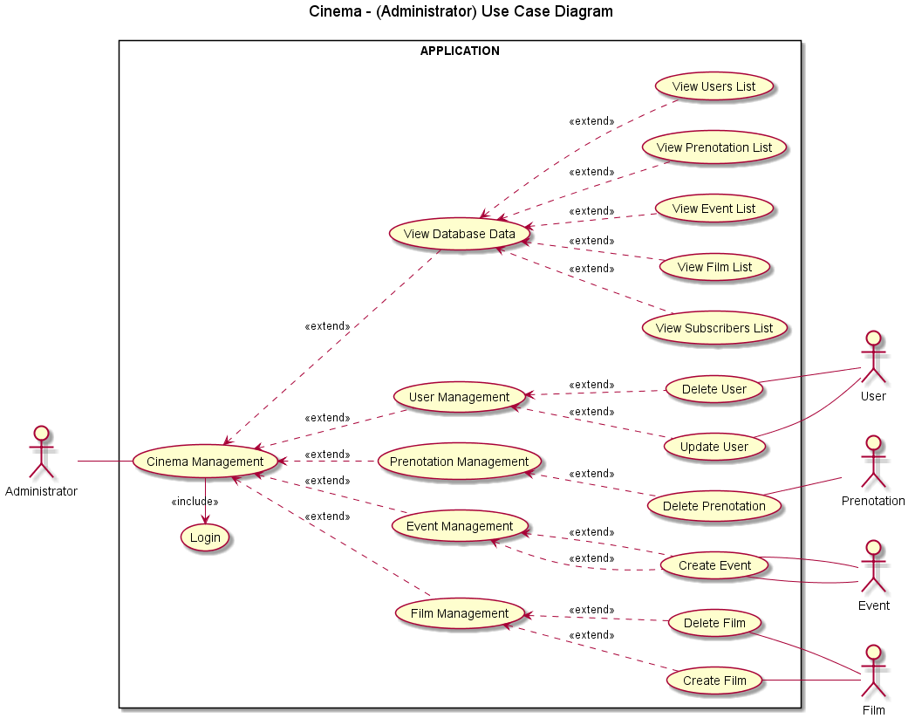
ADMIN
-
USE CASE DIAGRAM

Slide 5
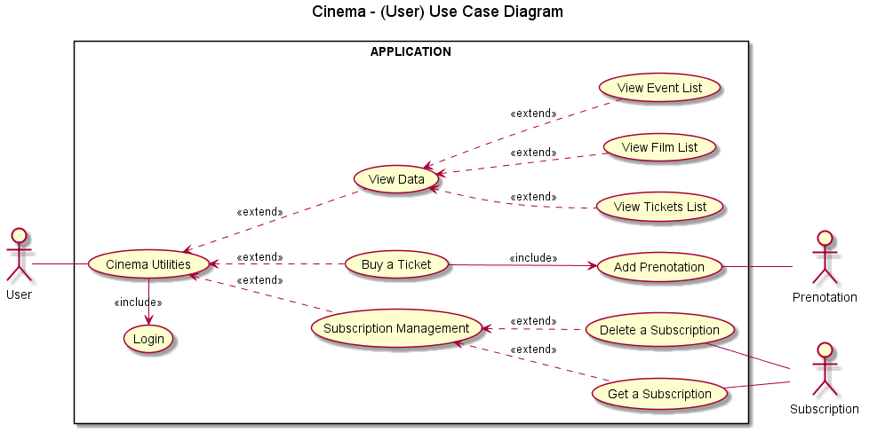
USER - USE CASE DIAGRAM

Slide 6
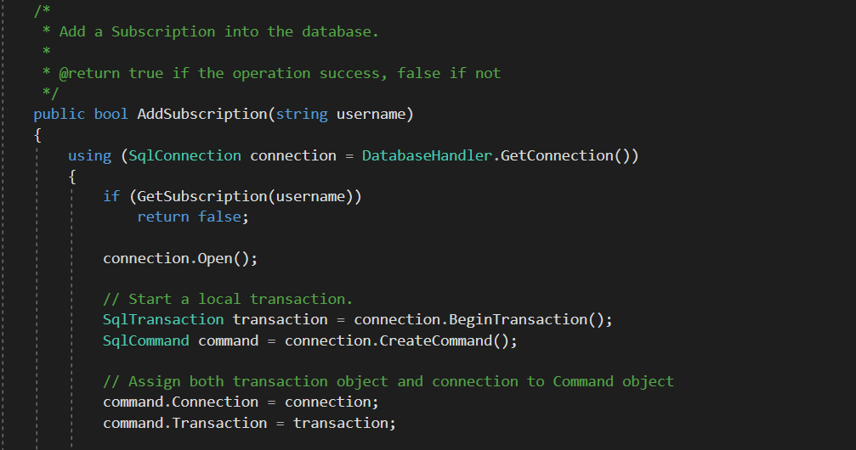
Use of transactions (1/3)

Slide 7
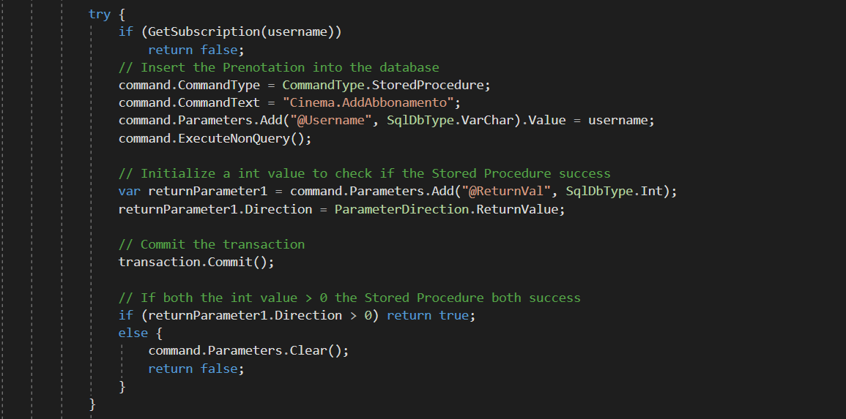
Use of transactions (2/3)

Slide 8
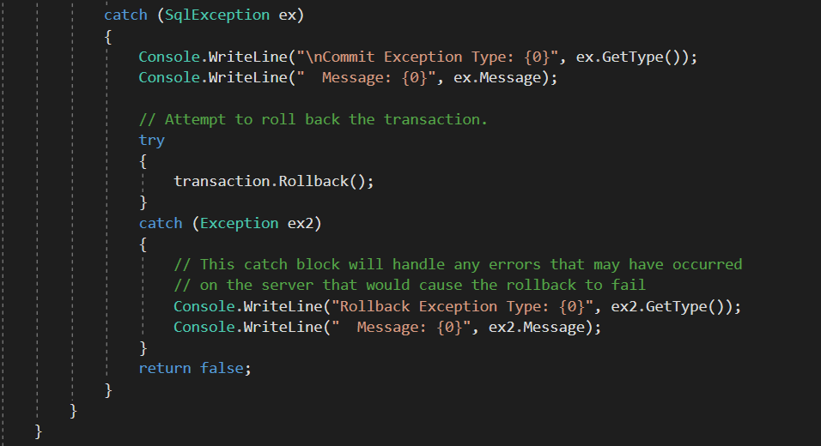
Use of transactions (3/3)

Slide 9
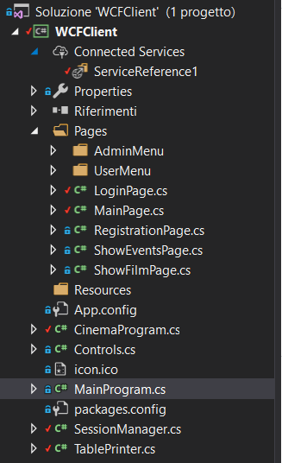
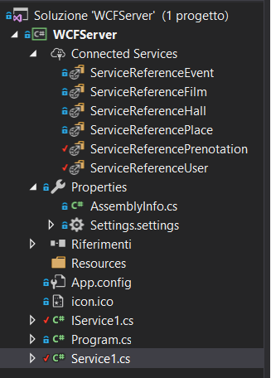
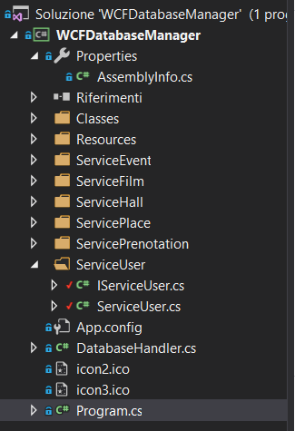
Use of Services (1/2)

Slide 10

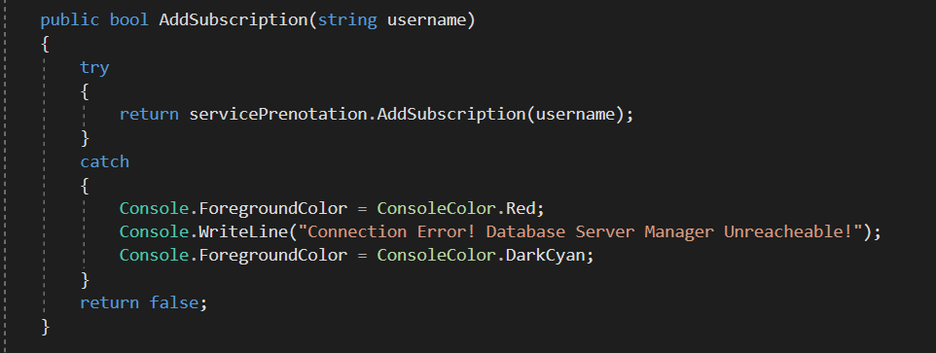
Use of Services (2/2)
IService1.cs
Service1.cs

Slide 11
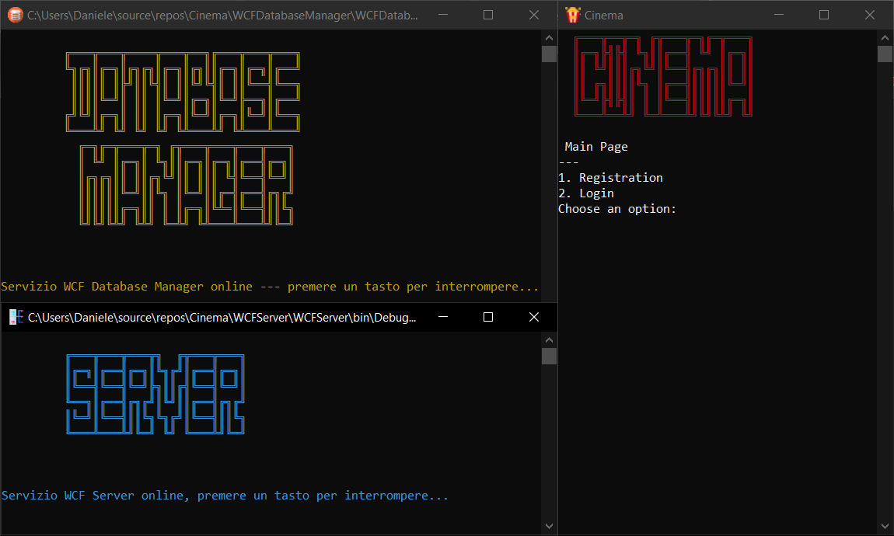
THE APPLICATION

Slide 12
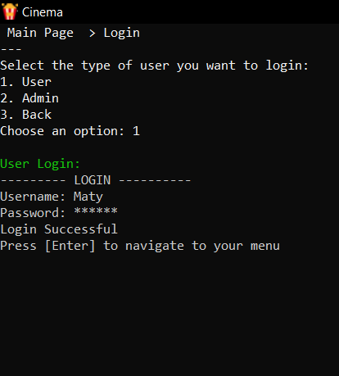
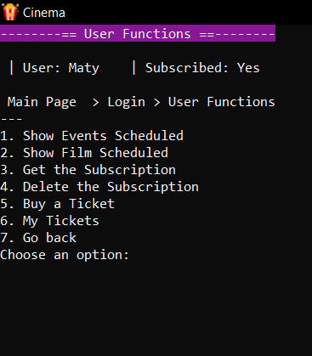
User Menu
Username: Maty
Password : qwerty

Slide 13
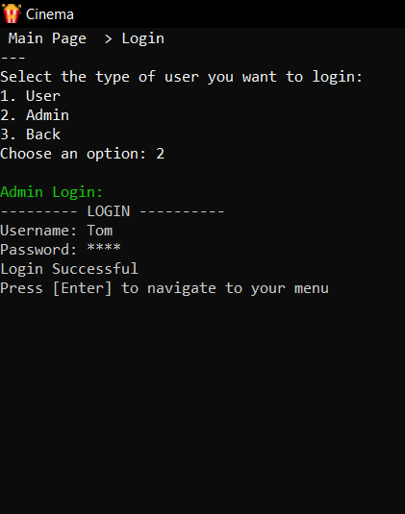
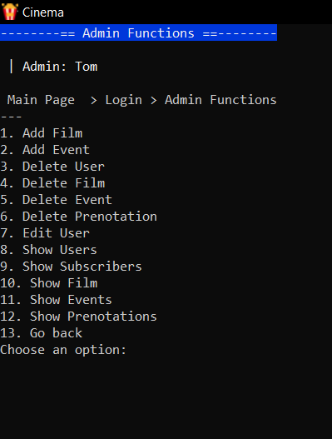
Admin Menu
Username: Tom
Password : 1234

